Slide 1
Introduction to Machine Learning
Teaching Demonstration
Ari Smith, Instructor, Department of Industrial and Systems Engineering
University of Wisconsin Madison

Slide 2
Today’s Lecture
Intro to ML via a Case Study
Case Study Part 1: Wine Rating
The Language of Machine Learning
Case Study Part 2: Modeling Wine Quality
Linear Regression: a Deeper Look
All files can be downloaded at https://ari-smith-research.github.io/TeachingDemo
Machine Learning in Action

Slide 3
Predicting the Quality of Wine
Introductory Case Study

Slide 4
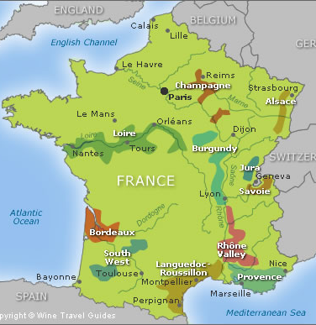
Bordeaux Wine
Bordeaux Wine is exclusively produced in the Bordeaux Region of France
Produced in the same way for hundreds of years
But significant differences in quality from vintage to vintage
Believed to taste better with age
But hard to predict the future quality of win when tasted at a “young” age
Machine Learning in Action

Slide 5
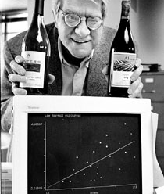
Professor Orley Ashenfelter
In March 1990, Prof. Ashenfelter announced that he could predict the quality of Bordeaux wines without tasting them
He believed that human experts were creating an inefficient market for young wines
Bad vintages are often overpriced
Good vintages are often underpriced
Machine Learning in Action

Slide 6
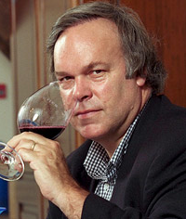
The Expert’s Reaction
Robert Parker, the world’s most influential wine expert:
“Ashenfelter is an absolute total sham… like a movie critic who never goes to se the movie but tells you how good it is based on the actors and director… ludicrous and absurd”
Machine Learning in Action

Slide 7
The Language of Machine Learning

Slide 8
What is Machine Learning?
The field of machine learning focuses on teaching machines how to learn
As Prof. Tom Mitchell put it:
“Machine learning is the study of computer algorithms that improve automatically through experience”
Machine learning algorithms are not provided with explicit instructions on how to perform a given task
The algorithms rely on patterns and experience to effectively learn
Machine Learning in Action

Slide 9
How is ML different from artificial intelligence?
AI focuses on teaching computers (Prof. Andrew Moore):
“to behave in ways that, until recently, we thought required human intelligence.”
AI is a moving target, based on what tasks we currently believe require human intelligence
Machine learning is one(of potentially many) ways to achieve artificial intelligence
Machine Learning in Action

Slide 10
Key Definitions
Target: The outcome that we want to predict
Features: The information that we use to predict the target
Observations: The data sample that we observe, including features and (sometimes) targets
Model: A function that maps the features to the target
Machine Learning in Action

Slide 11
Key Definitions
Training and testing: A process that partitions the observations into disjoint sets (i.e., they have no elements in common):
Training set: used to train the model to perform a task
Validation set: used to validate our modelling choices
Testing set: used to test the model performance using data that has not been seen before.
Fit: How well the model predicts the target
Machine Learning in Action

Slide 12
How do machines learn?
Supervised learning: teaches the machine to perform a task using observations that include both features and targets
Unsupervised learning: teaches the machine to perform a task using observations that only include features (no targets)
Reinforcement learning: teaches the machine to perform a task without using prior observations
Deep learning: teaches the machine to learn in an abstract way, without a specific task in mind
Machine Learning in Action

Slide 13
Classification vs. Regression
Regression: The target variable is continuous
Classification: The target variable is discrete
Binary if two groups
Multi-class for more than two groups
Machine Learning in Action

Slide 14
Predicting the Quality of Wine
Example Continued

Slide 15
Exploratory Data Analysis
Price is often used as a proxy for wine quality
Ashenfelter discovered two explanations for the observed variation in price
Age: older wines are more expensive
Weather: varies dramatically from year to year
Machine Learning in Action

Slide 16
How was the price of wine defined?
The price index measures the price of many different wines in thousands of wine auctions
normalized to the highest price
log(Price index) as the target in the linear regression model
Why log(Price index)?
Produces a better linear fit (discovered through plotting)
Inflation and other factors typically increase prices exponentially
Machine Learning in Action

Slide 17
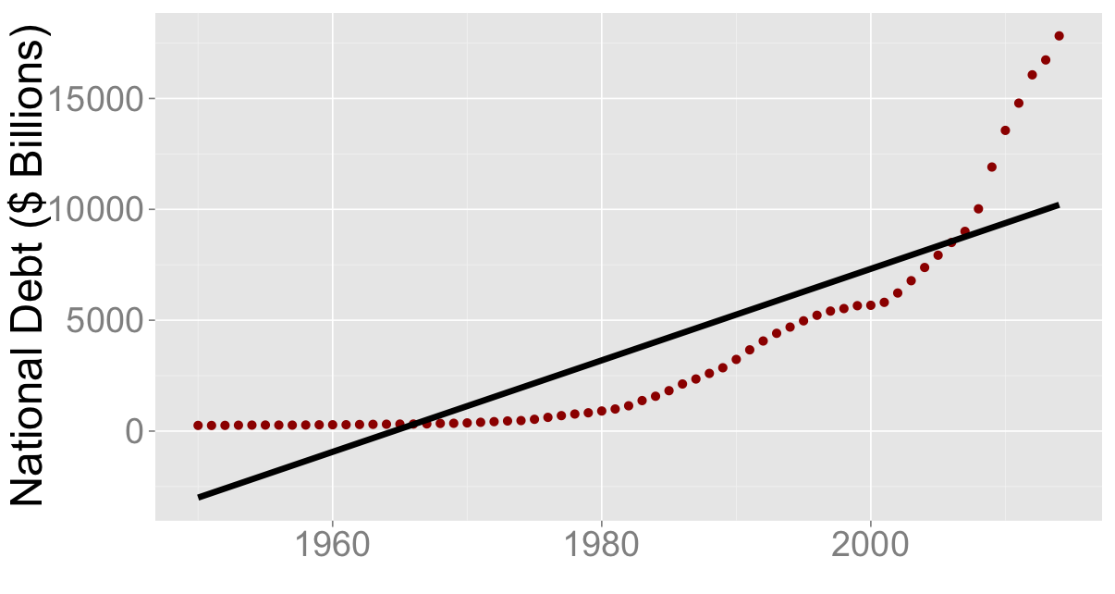
Log transform example
Machine Learning in Action

Slide 18
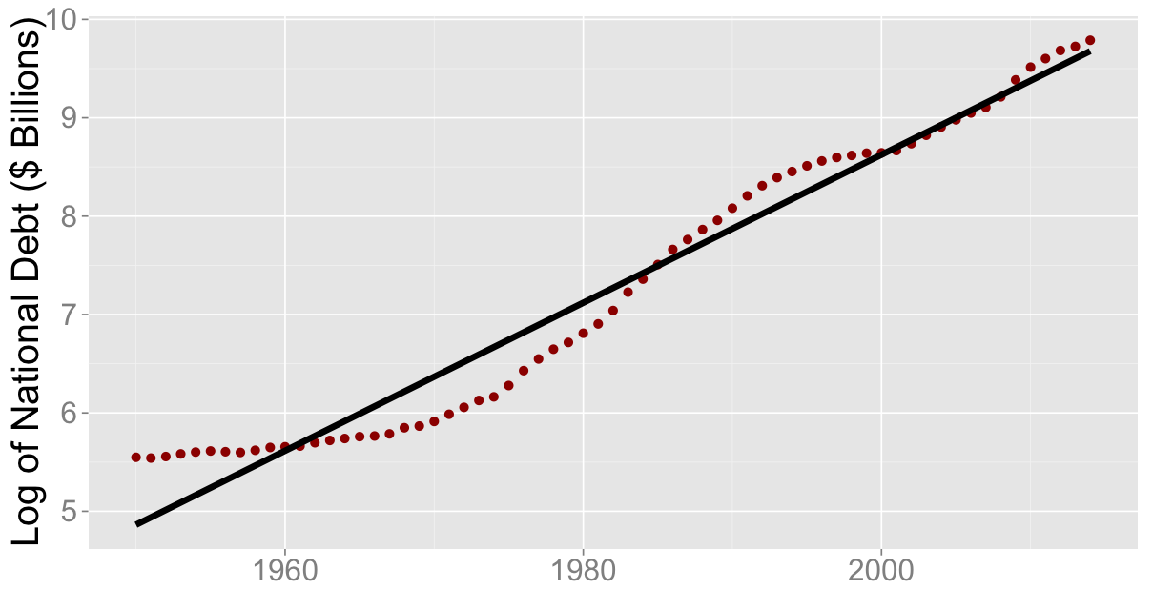
Log transform example
Machine Learning in Action

Slide 19
What features were used to predict the price of wine?
Four features:
Age
Winter rain (October - March)
Harvest rain (August - September)
Average growing season temperature (April - September)
What model was used?
Ashenfelter decided to use a linear regression model to predict the log(price) of wine
Machine Learning in Action

Slide 20
The final model
Log(price index) = -12.145 + 0.001167 (Winter rainfall) + 0.616 (Average growing season temp) – 0.00386 (Harvest rainfall) + 0.0238 (Age of vintage)
Wine magazine:
“the formula's self-evident silliness invites disrespect"
Bordeaux wine industry was outraged:
“How can he know anything about wine that he hasn't tasted?...Would you listen to a food critic who has never tasted the food?"
Machine Learning in Action

Slide 21
How did the model perform?
R² = 0.83 – model explains 83% of the variance in price
All features statistically significant
Robust to the addition of other features
Machine Learning in Action

Slide 22
What is R²?
SSE = 5.89
SST = 10.15
Machine Learning in Action

Slide 23
Can machine learning beat a human expert at predicting wine quality?
Parker in 1991:
1986 is “very good to sometimes exceptional"
Other years are average
Ashenfelter in 1991:
1986 is mediocre
1989 will be “the wine of the century” and 1990 will be even better!
In 2003, there was virtually unanimous agreement that 1989 and 1990 are outstanding wines
1989 sold for more than twice the price of 1986 and 1990 sold for even higher prices!
“Two of the best vintages in the last 50 years"
In 2003, Ashenfelter predicted 2000 and 2003 would be equally great
Parker has since stated: “2000 is the greatest vintage Bordeaux has ever produced"
Machine Learning in Action

Slide 24
Linear Regression

Slide 25
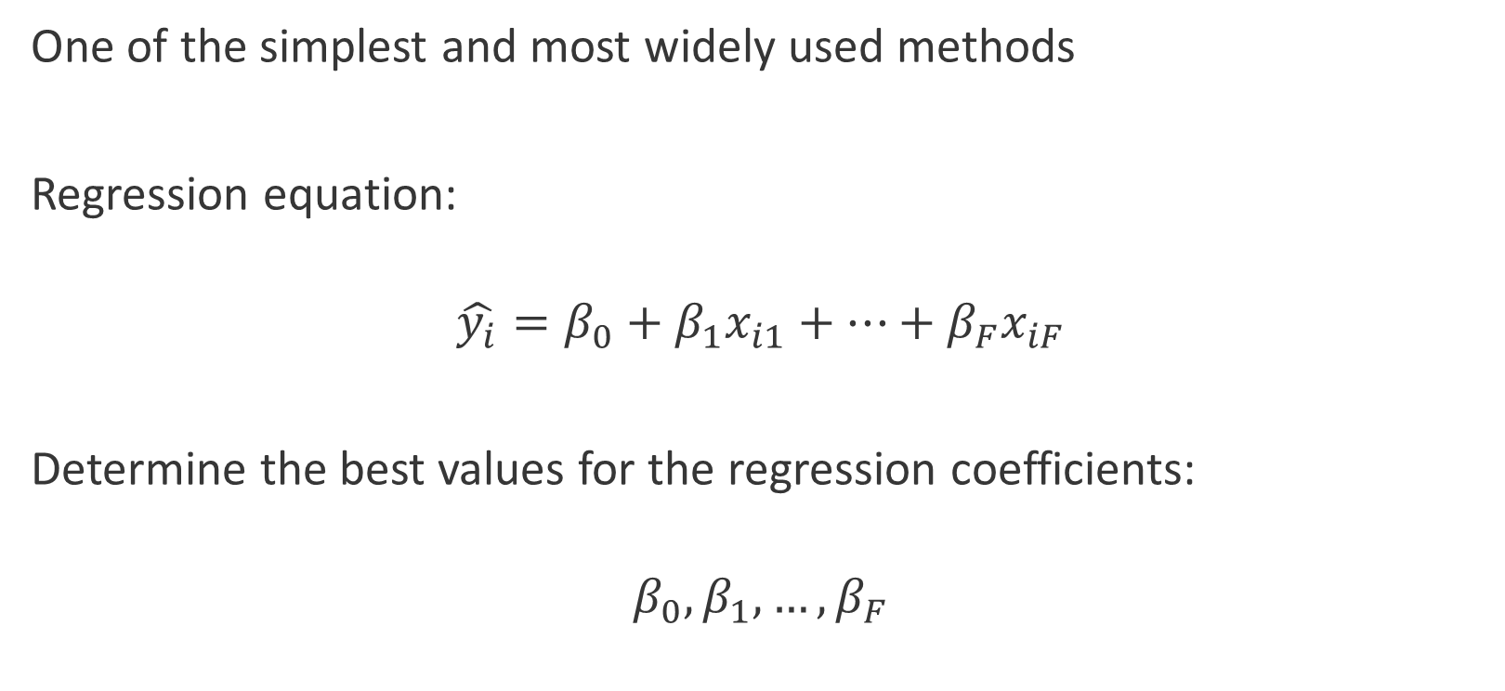
Overview
One of the simplest and most widely used methods
Regression equation:
$${\hat{y_{i}}=β}_{0}+β_{1}x_{i1}+…+β_{F}x_{iF}$$
Determine the best values for the regression coefficients:
$$β_{0},β_{1},…,β_{F}$$
Machine Learning in Action

Slide 26
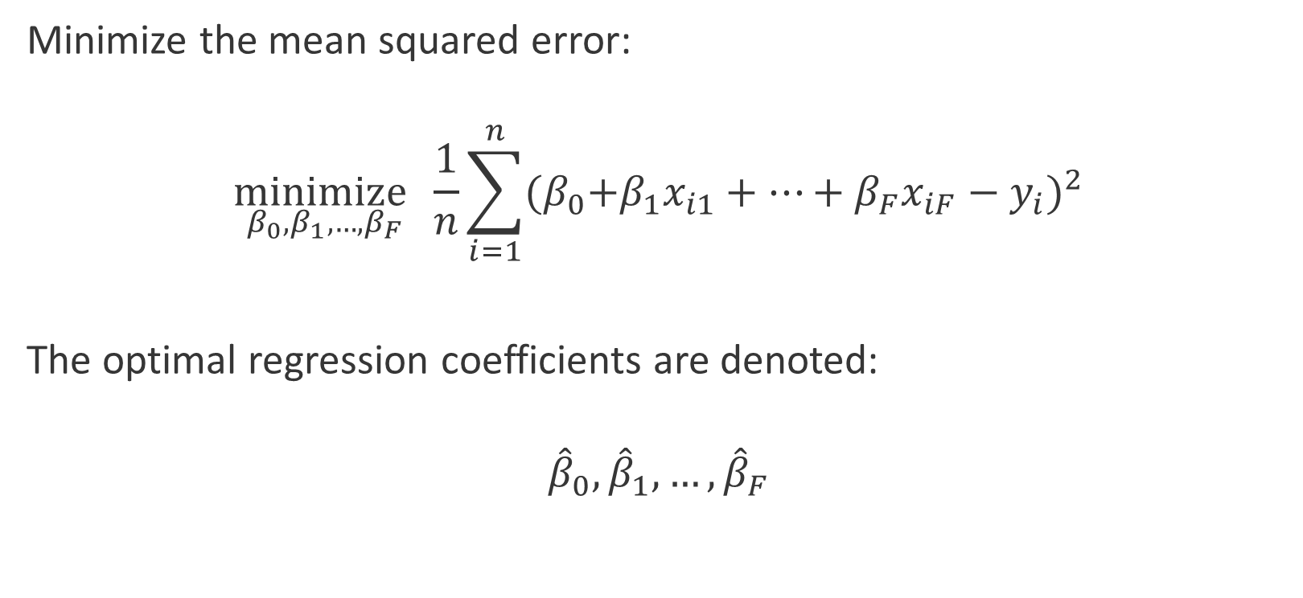
How do we fit the model?
Minimize the mean squared error:
$$\underset{β_{0},β_{1},…,β_{F} }{minimize}{\frac{1}{n}\sum_{i=1}^{n}{{{(β}_{0}+β_{1}x_{i1}+…+β_{F}x_{iF}−y_{i})}^{2}}}$$
The optimal regression coefficients are denoted:
$${\hat{β}}_{0},{\hat{β}}_{1},…,{\hat{β}}_{F}$$
Machine Learning in Action

Slide 27
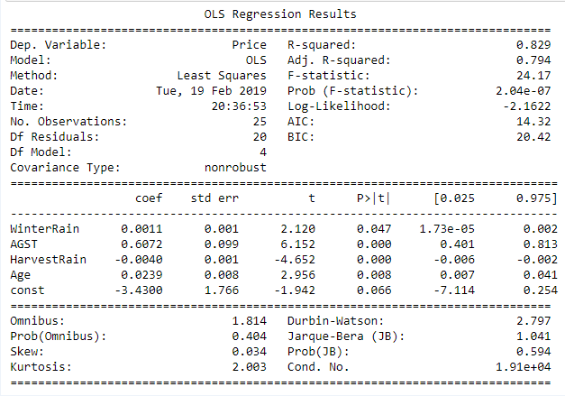
How do we interpret the model?
For every one year increase in the age of a wine, the price of wine increases by 2.42%
A one unit change in age increases the log(Price) by 0.0239 and the price by e^0.0239=1.0242
Machine Learning in Action

Slide 28
What are the model assumptions?
1. Weak exogeneity: The feature values are known exactly and not subject to error
2. Linearity: The target can be written as a linear combination of features
3. Constant variance or homoscedasticity: The variance of the error terms is constant across all samples
4. No autocorrelation: The error terms are not correlated with each other
5. Normality (or other): impacts the statistical tests used for the regression coefficients
Machine Learning in Action

Slide 29
How do we verify these assumptions?
We can use residual plots to verify assumptions 2, 3, and 4:
Machine Learning in Action

Slide 30
How do we verify these assumptions?
A QQ-plot can be used to verify normality:
Machine Learning in Action

Slide 31
How do we verify these assumptions?
Cook’s Distance and Leverage are used to identify potential outliers:
Machine Learning in Action

